Slide 1
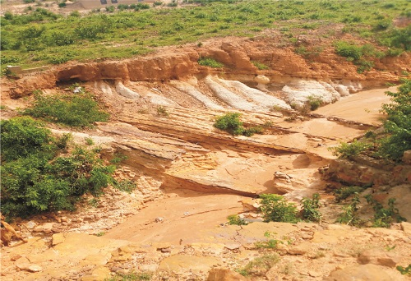
NEWMAP-EIB TECHNICAL REPORT
EIB-Assisted Nigeria
Climate Adaptation
Erosion and Watershed Project
Gombe State Gully Erosion Sites:
Comprehensive Technical and Socio-Economic Assessment
Gombe State Project Management Unit
Ministry of Environment, Water and Forest Resources
April 2026

Slide 2
PRESENTATION OVERVIEW
Contents
01
Introduction to the Crisis
02
Wuro Biriji to Doma Gully
Scale of gully erosion in Gombe State and NEWMAP-EIB intervention framework
15.4 km corridor - the most critical environmental challenge affecting 8 communities
03
Jauro Tukur Stream Bank (Kumo)
04
Gurama Quarters to Kundulum
Dual-threat system in one of Gombe's vital commercial and agricultural hubs
7.6 km corridor with severe building collapse risk in Gombe metropolis
05
Zagaina to Kundulum
06
Poshiya to COE Billiri
Active erosion zone affecting 20,000 people across 30 villages in Akko LGA
Major ecological flashpoint threatening Tangale heartland and College of Education
07
Conclusion & Institutional Response
Synthesis of catastrophic scale across all sites, integrated institutional response, and comprehensive action requirements for recovery and improved living standards

Slide 3
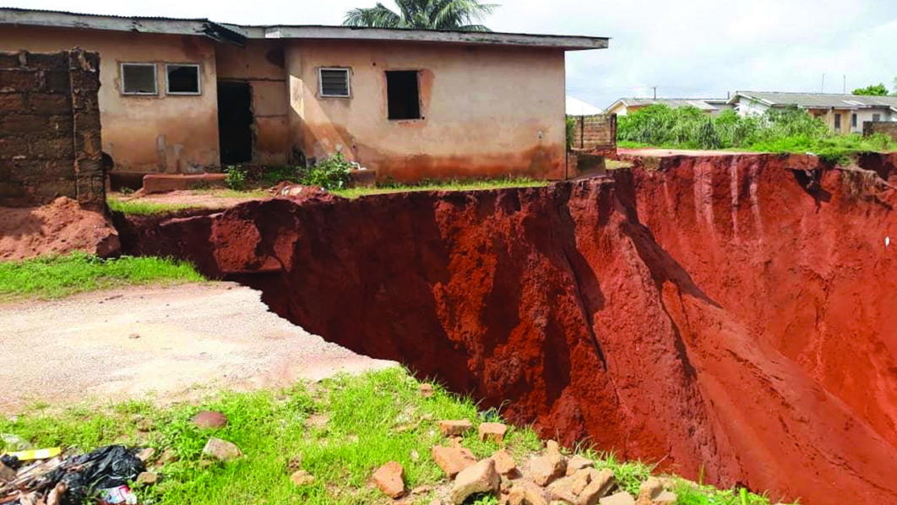
CHAPTER 01
Introduction to
the Crisis
Understanding the scale of gully erosion in Gombe State and the NEWMAP-EIB intervention framework

Slide 4
CHAPTER 01
Gombe State: The Gully Erosion Capital of the North-East
Catastrophic Scale of Environmental Degradation
Crisis Drivers
Gully erosion has transformed Gombe town, the state capital since 1996, into a zone of progressive environmental collapse. Over 200 active gullies now scar the landscape, with the crisis intensifying annually due to rapid urban expansion, demographic increase, and inadequate infrastructure.
Rapid Urbanization
Unplanned expansion replacing vegetation with concrete
Extreme Rainfall
Short, intense bursts exceeding drainage capacity
The social ramifications are devastating: advancing gully heads do not stop for property lines, swallowing foundations of homes, schools, and places of worship, creating a class of "environmental refugees" within the city.
Fragile Soil
Sandy-loam composition with low cohesion
Demographic Pressure
Population growth since 1996 state capital designation
Key Impact Statistics
"Every heavy downpour brings a mixture of necessity and dread, as the very rain required for crops simultaneously threatens to erase the ground beneath their feet."
297
11+
Cumulative deaths since 1996
People killed annually by flooding
— Resident testimony, Gombe metropolis
200+
200+
Active gullies in Gombe town
Communities ravaged

Slide 5
CHAPTER 01
NEWMAP-EIB Project Framework & Methodology
Project Structure
Five Assessment Sites
European Investment Bank (EIB)
1
Wuro Biriji to Doma
International financing and technical assistance
15.4 km | 8 communities | High exposure: 85%
Gombe State PMU
Ministry of Environment, Water and Forest Resources
2
Federal Project Management Unit
Jauro Tukur (Kumo)
National coordination and oversight
3.4 km | Stream bank erosion | High exposure: 80%
International Safeguards
3
Gurama to Kundulum
EIB ESS5 standards for resettlement and livelihood restoration
7.6 km | Gombe metropolis | High exposure: 70%
Assessment Methodology
4
Zagaina to Kundulum
6.8 km | 30 villages | High exposure: 40%
1
Field surveys and morphological analysis
2
Vegetation, soil, and climate characterization
5
Poshiya to COE Billiri
5.7 km | Billiri LGA | High exposure: 80%
3
Socio-economic baseline data collection
4
Stakeholder engagement and community consultations
5
Resettlement Action Plan (RAP) development
Key Principle
6
The project adheres to EIB ESS5 standards, requiring that affected persons achieve an improved standard of living, not merely a return to pre-project levels. Compensation alone is insufficient; active, participatory livelihood restoration is mandatory.
Gender-sensitive programming and vulnerable group assessment

Slide 6
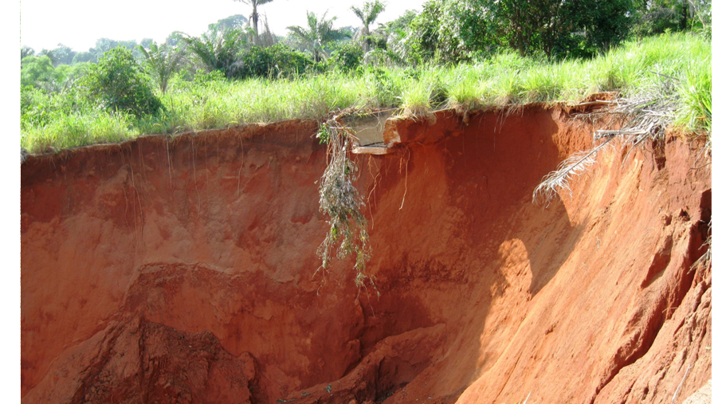
CHAPTER 02
Wuro Biriji
to Doma Gully
The most critical environmental challenge in Gombe State: 15.4 km corridor affecting 8 communities with 85% high population exposure

Slide 7
CHAPTER 02 | WURO BIRIJI-DOMA
Site Characteristics & Morphology
Technical Specifications
Vegetation, Soil & Climate Profile
Total Length
15.4 km
Vegetation
Soil
Climate
Width Range
10-50 m
Sudan savannah transitioning to Guinea savannah. Open woodland with scattered drought-resistant trees (shea, locust bean, thorn trees). Degraded from fuelwood harvesting, overgrazing, cultivation expansion.
Sandy loam (dominant), well-drained, low water retention. Lateritic soils (Wawa-type) with moderate strength. Clayey soils in lowlands with poor drainage. Slightly acidic to neutral pH, low organic matter.
Tropical wet-and-dry savannah. Annual rainfall: 800-900mm. Wet season: April-October, peak July-September. Mean temperature: 30-34°C. Harmattan winds in dry season.
Communities Affected
8
High Exposure
85%
UTM Coordinates
Causes & Trend Analysis
Start: 734489.70m E, 1134011.66m N
Primary Causes
Trend
End: 743755.98m E, 1137687.78m N
Overgrazing and vegetation loss
Severe Expansion
Runoff from hills at gully heads
Loose sandy-loam soil composition
Rapid headward erosion with chasms reaching 10-15 meters depth. Self-perpetuating cycle where topsoil loss prevents natural stabilization.
Affected Communities
Extreme rainfall events
Wuro Biriji
Wuro Shiji
Sarankiyo
Bomala
Engineering Concerns: Erosion control structures required, soil stabilization needed in sandy stretches, drainage design critical in sandy loamy/flood-prone areas.
Wuro Baduku
Wuro Galadima
Tabra
Doma

Slide 8
CHAPTER 02 | WURO BIRIJI-DOMA
Environmental & Ecological Impacts
Land Degradation & Biodiversity Loss
Impact Severity Matrix
Erosion creates massive chasms reaching 10-15 meters depth, destroying topsoil and stripping land of nutrients. Indigenous flora cannot thrive, leading to permanent ecological damage and localized loss of biodiversity as habitats for small fauna are disrupted.
Land Degradation
Critical
Biodiversity Loss
Severe
Water System Damage
Severe
Topographic Alteration
Critical
Siltation of Water Bodies
Soil washed from the Wuro Biriji axis ends up in local drainage systems and downstream rivers. Sedimentation reduces water-carrying capacity of streams, leading to secondary flooding in lower-lying areas and compromising water quality for domestic use.
Key Impact Statistics
10-15m
85%
Gully Depth
High Population Exposure
Alteration of Topography
8
15.4 km
Rapid "fingering" of gullies creates a fragmented landscape that is difficult to reclaim or stabilize without heavy engineering intervention. The topography is permanently altered, creating a self-perpetuating cycle of collapse.
Communities Affected
Total Length
Mitigation Research: Ipomoea carnea planting demonstrated 38% decrease in gully depth and 27% decrease in width after 12 months, showing potential for bioremediation approaches.

Slide 9
CHAPTER 02 | WURO BIRIJI-DOMA
Sociocultural, Human & Livelihood Impacts
Sociocultural Impacts
Human Impacts
Livelihood Impacts
Community Breakdown
Displacement & Shelter Loss
Agricultural Loss
Displacement scatters families, dismantling informal safety nets. Elderly lose care support.
Hundreds of households forced to abandon ancestral homes as gully encroaches.
Grazing land loss, farm lands loss, economic trees (mango, neem, moringa) destroyed.
Governance Disruption
Health Crises
Business Destruction
Traditional leaders lose authority over scattered constituents. New CICs needed.
Waterborne diseases from contaminated wells, malnutrition, mental health distress, physical injuries.
Roadside kiosks, grain grinding, tailoring shops, auto repair sheds lose workspace and customer base.
Social Tensions
Impoverishment
Common Resources
Competition for land, water, and jobs between displaced and host communities.
Loss of farmland and small enterprises pushes families below poverty line. Cash compensation insufficient.
Loss of access to water sources, pasture, forest, woodland, medicinal plants, fisheries.
Gender Disruption
Family Dissolution
Wage Labor Disruption
Women separated from kin-based support, increasing vulnerability to GBV.
Stress leads to abandonment of elderly, separation of spouses, children sent to relatives.
Daily laborers, farmhands, transport workers lose income as roads become impassable.
Cultural Loss
Vulnerable Groups
Tenancy Arrangements
Ancestral land with burial grounds and sacred groves lost. Cash cannot remedy spiritual distress.
Elderly, persons with disabilities, female-headed households, and the poor suffer disproportionately.
Sharecroppers and tenants lose entire food source while landlords receive compensation.
Key Principle: Compensation alone is insufficient. Livelihood restoration must be active, participatory, and monitored to achieve improved living standards.

Slide 10
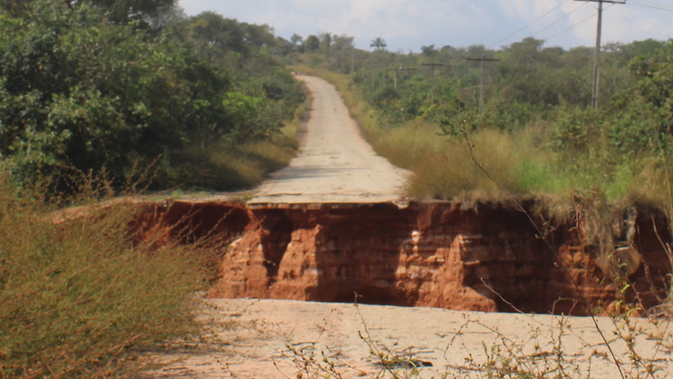
CHAPTER 03
Jauro Tukur
Stream Bank (Kumo)
Dual-threat system combining riverine erosion with gully formation in one of Gombe's vital commercial and agricultural hubs

Slide 11
CHAPTER 03 | JAURO TUKUR-KUMO
Site Characteristics & Environmental Impacts
Technical Specifications
Unique Dual-Threat Characteristic
Total Length
3.4 km
Unlike isolated gullies, the Jauro Tukur stream bank combines bank failure (riverine erosion) with traditional gully formation. During peak rainy season, high-volume discharge causes banks to collapse, leading to massive widening of the stream bed.
Width Range
15-50 m
High Exposure
80%
Bank Instability
Riparian Loss
Constant undercutting by flowing water causes banks to collapse during rainy season.
Trees and shrubs that stabilize banks are uprooted, removing biological anchors.
Trend
Gradual → Accelerating
Downstream Siltation
Arable Land Loss
UTM Coordinates
Sand and silt clog waterways, reducing reservoir and irrigation channel capacity.
Erosion eats into fertile floodplains (Fadama lands), reducing dry-season farming acreage.
Start: 741601.68m E, 1113308.48m N
End: 743942.75m E, 1111858.12m N
Vegetation, Soil & Climate
Affected Communities
Veg: Savannah grassland with scattered trees (thorny, locust bean, neem). Degraded riparian vegetation.
Soil: Sandy loam (dominant, loose, highly erodible), alluvial soils along channels, clayey in lowlands.
Climate: Tropical wet-dry, 800-900mm rainfall, April-October wet season, mean temp 30-34°C.
Jauro Musa (most severely affected)
Kumo environs (Akko LGA headquarters)
Engineering Challenge: Stabilizing a stream bank (river training) is technically different and often more expensive than filling a standard gully. Requires sophisticated hydraulic modeling.

Slide 12
CHAPTER 03 | JAURO TUKUR-KUMO
Socio-Economic & Human Impacts
Economic Impact on Kumo
Health Crisis in Unguwar Jauro Musa
Kumo is home to one of the largest grain markets in Northern Nigeria. Erosion threatens bridges and access roads transporting goods from rural farms to the central market, potentially driving up food prices across the region.
Waterborne Diseases
Floodwater passes through homes, contaminating wells with sewage and silt. Increased cholera, typhoid, diarrhoea.
Malnutrition
Market Linkages Threatened: Bridges and access roads at risk
Loss of 10-hectare farms collapses household food production. Reduced income limits nutritious food purchases.
Residential Destruction: Homes compromised by receding banks
Mental Health Distress
Farmland Loss: Small-scale farmers losing irrigation-dependent land
Residents "sleep with our eyes open whenever it rains." Chronic anxiety, depression, post-traumatic stress.
Drowning Risks: Fast-moving torrent during heavy rains
Physical Injuries
Children and elderly at risk of falls, cuts, building collapses during heavy rains.
Case Studies: Human Cost
GBV Risk
Displacement increases vulnerability due to overcrowded shelters, loss of protective networks, economic desperation.
Muhammadu Babandudu (70)
Lived with wife and 10 children for 40+ years in Unguwar Jauro Musa. Compelled to relocate in 2020 after house destroyed by downpour. Of original 8 rooms, only 6 remain, in imminent danger.
Displacement Scale
Malam Musa Kawuwa
300+ households forced to abandon dwellings in Unguwar Jauro Musa over 23 years. Each relocation is physically exhausting and emotionally draining, eroding capacity to recover.
Tailor and farmer. Lost entire four-bedroom house and 10-hectare farm in 2014. Rebuilt only to find new structure threatened again.
Key Challenges
• Intensity of flash floods exceeding drainage capacity
• Illegal sand mining weakening soil structure
• Engineering complexity of river training vs. standard gully filling

Slide 13
CHAPTER 04
Gurama Quarters
to Kundulum
Catastrophic erosion in Gombe metropolis: 7.6 km corridor with severe building collapse risk and road disconnection

Slide 14
CHAPTER 04 | GURAMA-KUNDULUM
Site Characteristics & Morphology
Technical Specifications
Vegetation, Soil & Climate Profile
Total Length
7.6 km
Vegetation
Soil
Climate
Width Range
15-30 m
Sudan savannah belt with scattered medium-height trees (8-15m): locust bean, shea tree, Acacia spp. Degraded from fuelwood extraction, grazing pressure, bush burning. Low to moderate density.
Sandy loam (widespread, well-drained, low cohesion). Lateritic soils with moderate load-bearing capacity. Clayey soils in depressions. Slightly acidic to neutral pH, low organic content.
Tropical savannah (wet-dry). Annual rainfall: 800-900mm. Wet season: April-October, peak July-September. Mean temperature: 30-34°C. Harmattan dry season with dusty northeast trade winds.
High Exposure
70%
20-Year Trend
Rapid Expansion
UTM Zone 32N Coordinates
Causes & Engineering Concerns
Start: 736573.19m E, 1141261.72m N
Primary Causes
Engineering Requirements
End: 742598.82m E, 1142479.87m N
Urban runoff concentration
Soil stabilization (lime/cement)
Poor drainage systems
Critical drainage design in clay zones
Blocked channels
Erosion control along embankments
Nearby Communities
Uncontrolled urbanization
Headward erosion mitigation
Gurama Quarters
Kundulum
Arawa
Gombe metropolis
Critical Context: Gombe town contains over 200 active gullies that have flooded and killed at least 11 people every year, with a cumulative death toll of 297 since 1996.

Slide 15
CHAPTER 04 | GURAMA-KUNDULUM
Environmental & Social Impacts
Environmental Toll
Social & Economic Impacts
Massive Land Loss
Infrastructure Collapse
Gully expanded into "canyon-like" structure. Retrogressive erosion consumes hectares of urban and peri-urban land that can never be recovered.
Dozens of houses, perimeter walls, and utility poles swallowed or severely damaged. Life savings tied up in properties now valued at zero.
Natural Drainage Destruction
Gully acts as violent funnel for storm runoff, increasing water velocity and causing deeper scouring.
Soil Fertility Loss
Severed Connectivity
A-horizon (topsoil) stripped, leaving barren subsoil. Prevents regrowth of stabilizing grass and trees.
Vital link between Gurama Quarters and Kundulum cut off. Residents forced to take long, difficult detours to reach schools or markets.
Groundwater Impact
Deep gullies lower local water table, affecting moisture levels and potentially impacting community wells.
Public Health Risks
Stagnant water breeding mosquitoes (malaria) and water-borne pathogens. Illegal refuse dumping creates foul odours and hygiene issues.
Broader Gombe Metropolis Crisis
200+
297
Displacement & Poverty
Families forced to evacuate become internally displaced. Without compensation, middle and low-income families pushed into extreme poverty.
Active gullies
Deaths since 1996
8,640
21 km
State-Level Challenges
People at risk (720 households)
Gully corridor (FCE-Tech to Railway)
Geological Vulnerability: Sandy-loam soil lacks cohesive strength to resist high-velocity water.
Uncontrolled Urbanization: Building on waterways without drainage creates "finger gullies."
High Reclamation Cost: Massive gabions, check dams, concrete channelling exceed state budget.
Maintenance Issues: Channels clogged with silt and plastic waste, failing during peak rains.

Slide 16
CHAPTER 04 | GURAMA-KUNDULUM
Human & Livelihood Impacts
Human Impacts
Livelihood Destruction
Institutional Response
Physical Displacement
Agricultural Loss
Compensation Package
Over 200 houses washed away in Bogo/BCGA area alone. Millions of naira in property damage.
Gullies "consuming entire farms." Economic trees (mango, neem, moringa) destroyed. RAP requires "full replacement cost" valuation.
Gombe State approved N2.1 billion compensation for those affected within 10-meter buffer zones.
Health Catastrophe
Business Collapse
Mega Project
Gullies became "sites for open defecation and dumping wastes." Waterborne diseases, malnutrition, mental health distress.
Roadside kiosks, grain grinding, tailoring, auto repair destroyed. Each rainfall "halts businesses."
Signed multi-billion Naira contract for 18-km gully erosion control project within Gombe metropolitan city.
Drowning & Injury
Common Resources
Livelihood Support
5 people drowned in 2022 crossing makeshift bridge. Physical injuries from falls and structural collapses.
Seasonal streams, shallow wells, woodland, pasture destroyed. Women and girls walk longer distances for water.
Government supporting communities with livelihood-enhancing interventions beyond engineering works.
Healthcare Access
Wage Labor Disruption
Grievance Mechanism
Transportation "very difficult" for pregnant women. Over 1.6 million people exposed to health risks crossing gully.
Daily laborers, farmhands, motorcycle taxi riders lose income. No formal contracts or severance benefits.
About 700 complaints received for Doma gully project, each documented and reviewed for fairness.
Crime & GBV
Tenancy & Sharecropping
Thieves use gullies as hideouts, emerging to "rob, rape, and harass" residents crossing or in nearby houses.
Landlords receive compensation for "unexhausted improvements" while sharecroppers lose entire food source.
Governor's Vision: "These projects transcend civil engineering. They are life-saving, economy-boosting, and future-securing investments."
— Governor Inuwa Yahaya
Vicious Cycle
Livelihood loss → Poverty → Malnutrition → Family dissolution → Broken social networks → Increased vulnerability → Loss of shared resources → Long-term poverty
Key Infrastructure
Constructed four-span bridge at Hayin Kwarin Misau for N4.2 billion, reconnecting isolated neighborhood. Described as "a bridge to inclusion, safety, and economic participation."

Slide 17
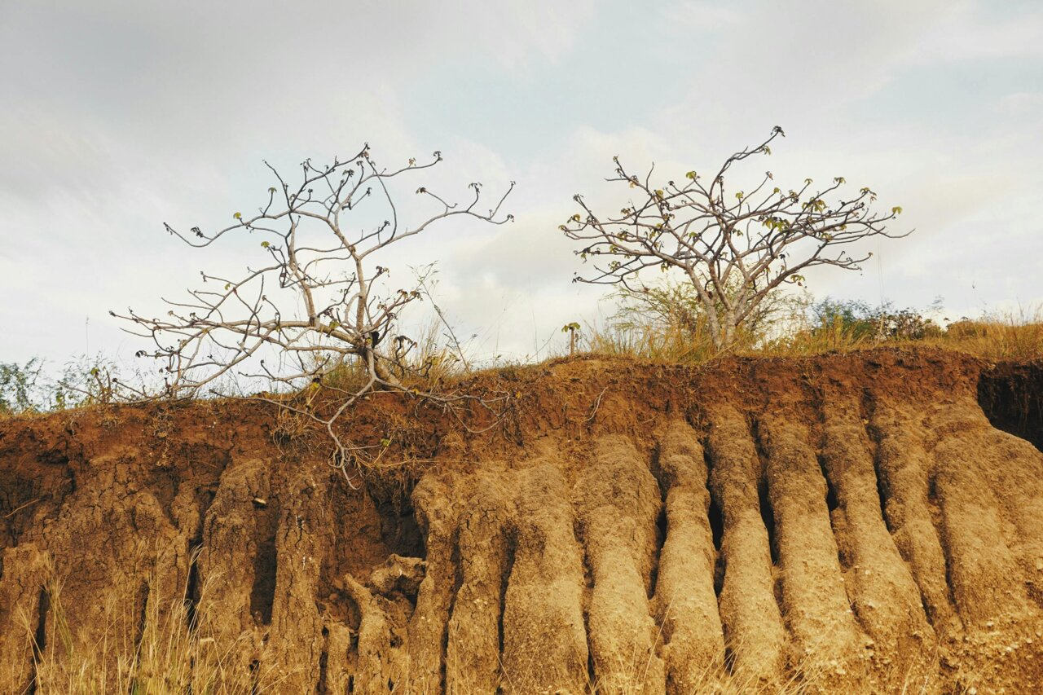
CHAPTER 05
Zagaina
to Kundulum
Active erosion zone affecting 20,000 people across 30 villages in Akko Local Government Area

Slide 18
CHAPTER 05 | ZAGAINA-KUNDULUM
Site Characteristics & Morphology
Technical Specifications
Vegetation, Soil & Climate Profile
Total Length
6.8 km
Vegetation
Soil
Climate
Width Range
5-25 m
Sudan savannah with scattered trees (locust bean, shea, Acacia). Extensive rain-fed agriculture, fallow lands, grazing fields. Degraded from bush burning, overgrazing, fuelwood extraction.
Sandy loam (predominant, loose, low cohesion). Lateritic soils with moderate bearing capacity. Clay in depressions. Slightly acidic to neutral pH, low organic matter, prone to gully erosion.
Tropical wet-dry savannah. Annual rainfall: 800-900mm. Wet season: April-October, peak July-September. Mean temperature: 30-34°C. Harmattan dry season with dusty winds.
High Exposure
40%
Population Affected
~20,000 people
UTM Coordinates
Causes & Challenges
Start: 737301.66m E, 1142127.00m N
Primary Causes
Intervention Challenges
End: 742828.40m E, 1142850.65m N
Poor drainage systems
Geological vulnerability (sand content >50%)
High rainfall intensity
Stormwater volume from urbanization
Rapid urbanization with impervious surfaces
Drainage "waterfalls" initiating new gully heads
Key Communities (30+ Villages)
Sand mining at gully base
High cost of gabions and concrete lining
• Zagaina
• Kundulum
Refuse dumping blocking channels
Scale outpaces available funding
• Sudaniya
• Wuro Bogga
• Alkahira
• Arawa A & B
Trend: Rapid lateral widening. The gully physically "tears" through neighborhoods, with hundreds of houses collapsed or with exposed foundations.
• Beto
• Wuro Kesa
• Wuro Gallo
• 20+ others

Slide 19
CHAPTER 05 | ZAGAINA-KUNDULUM
Environmental & Social Impacts
Environmental Degradation
Social Impacts
Topsoil & Land Loss
Displacement & Homelessness
Huge volumes of fertile sandy-loam soil washed away annually, leaving deep, unproductive ravines.
Hundreds of houses collapsed or foundations exposed, forcing families to abandon ancestral homes.
Vegetation Destruction
Headward erosion uproots indigenous trees and shrubs, leading to biodiversity loss and increased local temperatures.
Threat to Life
Hydrological Alteration
During peak rainy season (July-August), gullies become "death traps." Children swept away by high-velocity runoff.
Gully acts as massive artificial drain, lowering water table and increasing surface runoff velocity, exacerbating downstream flooding.
Sedimentation
Infrastructure Collapse
Displaced soil silts local waterways and drainage channels, reducing capacity and causing secondary flooding.
Critical access roads cut off, isolating communities from schools, hospitals, and markets.
Psychological Stress
Kundulum District Context
Constant anxiety as residents watch land value plummet and safety disappear with every heavy downpour.
Demographics
Approximately 20,000 people spread across over 30 villages under Hakimi's traditional leadership.
Maternal Health Crisis in Kundulum
Ethnic Composition
Women in Kundulum dread to be in labour at night. The only health centre serving 20,000 people has irregular medicine and workers not keeping to time. When it rains, the river floods and no one can cross. Women in labour deliver babies at the bank of the river when they can no longer endure it.
Predominantly Fulani and Kanuri ethnic groups with deep pastoral and agrarian traditions intimately tied to the land.
— Abubakar Adamu Kundulum, District Head's Secretary

Slide 20
CHAPTER 05 | ZAGAINA-KUNDULUM
Human & Livelihood Impacts
Human Impacts
Livelihood Destruction
Institutional Response
Physical Displacement
Agricultural Loss
EIB Pledge
Across Gombe State, no fewer than 200 communities ravaged, consuming thousands of hectares, destroying homes, leaving families homeless.
Advancing gullies "consuming entire farms." EIB identified Kundulun and Arawa as active erosion areas. Economic trees (mango, neem, shea) gone.
NPC coordinator Engr. Anda Ayuba Yalaks: "We are committed to supporting Gombe State. Our assessment will guide effective interventions."
Health Catastrophe
Business Collapse
State Investment
Waterborne diseases from contaminated water. Malnutrition from collapsed food production. Mental health distress with "widespread panic" during rains.
Roadside kiosks, grain grinding, tailoring, auto repair devastated. Each rainfall "halts businesses."
Gombe State paid N500 million counterpart funding for NEWMAP-EIB project. Signed multi-billion Naira contract for 18km control project.
Drowning & Injury
Common Resources
Compensation
In 2023, more than 10 people could not get home due to heavy downpour. In 2022, 5 people drowned crossing makeshift bridge.
Seasonal streams and shallow wells destroyed. Women and girls walk longer distances for water. Woodland providing firewood and poles lost.
Approved over N50 billion for gully erosion control and compensation, including N2.1 billion for 10-meter buffer zone affected persons.
Healthcare Access
Wage Labor Disruption
FOYAE-UNDP Initiative
Transportation "very difficult" for pregnant women. Community leader: "If you want to take a pregnant woman to health facility, it is a very hard process."
Daily laborers, farmhands, motorcycle taxi riders lose income. Roads impassable, demand for services reduced.
Foundation for Youth Awakening and Empowerment, with UNDP GEF-SGP support, launched initiative: drilling boreholes, building stone walls, planting 1,500 trees.
Crime & GBV
Educational Loss
Community Committee
Thieves use gullies as hideouts, emerging to "rob, rape, and harass" those crossing or in nearby houses.
When river flooded, children cannot cross to attend school. Erosion destroyed classrooms, splitting pupils into morning and afternoon sessions.
Established community environmental protection committee with representatives from various groups to oversee implementation.
Vicious Cycle
Success Story: 65 hectares already recovered through concrete work and backfilling. Over 1.6 million people from Akko and Gombe LGAs benefited from usable road.
Livelihood loss → Poverty → Malnutrition → Family dissolution → Broken social networks → Increased vulnerability → Loss of shared resources → Long-term poverty
Livelihood Restoration
GGMC Doma project will empower communities with fishponds, poultry farms, and other sustainable initiatives. Governor commissioned distribution of 12 tractors, 3 Hilux vehicles, 12 tricycles, 1 Hiace bus.

Slide 21
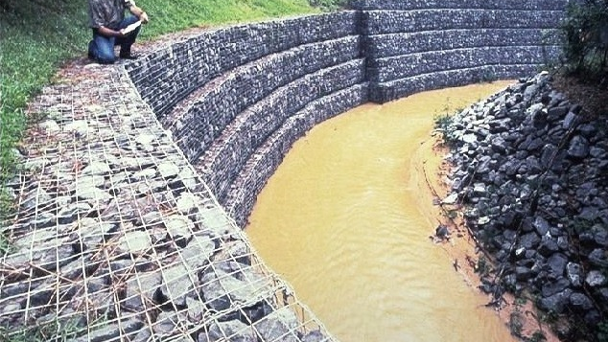
CHAPTER 06
Poshiya to
COE Billiri
Major ecological flashpoint in Billiri LGA threatening the Tangale heartland and College of Education

Slide 22
CHAPTER 06 | POSHIYA-COE BILLIRI
Site Characteristics & Morphology
Technical Specifications
Vegetation, Soil & Climate Profile
Total Length
5.7 km
Vegetation
Soil
Climate
Width Range
15-30 m
Guinea savannah (relatively wetter). Moderate to dense tree cover with well-developed grass understory. Common species: shea tree, locust bean, Daniellia oliveri. Riparian vegetation along streams.
Loamy and sandy-loam soils (dominant, moderately fertile, well-drained). Lateritic soils (reddish, compact). Clay soils in valley bottoms. Slightly acidic to neutral pH, moderate organic matter.
Tropical wet-dry, slightly higher rainfall than northern Gombe. Annual rainfall: 900-1100mm. Wet season: April-October. Mean temperature: 28-32°C (cooler due to elevation).
High Exposure
80%
Gully Depth
8-12 meters
Unique Threat to College of Education
UTM Coordinates
Start: ~744000 E, 1098000 N
The gully at the College of Education, Billiri poses an urgent threat from the south. The Provost, Dr. Bertha Abdu Danja, highlighted during a visit by the Commissioner for Higher Education that academic blocks, hostels, and staff quarters are increasingly vulnerable. The college's incomplete perimeter fence has already raised security concerns, and the advancing gully adds an existential threat to students, staff, and property.
End: ~741500 E, 1103000 N
Affected Communities
Pochiya (growing residential area)
Causes & Trend
Billiri (Tangale Chiefdom heartland)
COE Billiri surroundings
Primary Causes
Trend
Gada Uku
Road runoff concentration
Longitudinal Expansion
Lack of culverts
Rapid "headward" expansion eating backwards into higher ground, with channel deepening reaching 8-12 meters.
Steep terrain giving runoff kinetic energy
Fragile soil on slopes

Slide 23
CHAPTER 06 | POSHIYA-COE BILLIRI
Environmental & Social Impacts
Environmental Impacts
Social & Economic Impacts
Massive Land Subsidence
Threat to COE Billiri
Gully depths of 8-12 meters trigger landslides along banks, permanently altering local topography.
Academic blocks, hostels, and staff quarters increasingly vulnerable. Foundation exposure already occurring. Incomplete perimeter fence adds security vulnerability.
Vegetation & Reforestation Loss
Natural "green belt" protecting Billiri hillsides stripped. Exposed subsoil too acidic for regrowth, creating "moon-like" barren landscape.
Watershed Disruption
Education Disruption
Channels high-velocity runoff from Posh highlands toward COE campus and lower Billiri town, bypassing natural infiltration and causing flash flooding.
Psychological impact on students and staff "living on the edge." Campus and road to Posh become impassable during heavy rains, cutting off lecture access.
Sedimentation
Tons of silt clog local streams, reducing drainage capacity and water quality for downstream domestic use.
Residential Property Loss
Posh homeowners see property values plummet as gully nears doorsteps. Families forced to abandon houses without compensation, leading to internal displacement.
Billiri Regional Challenges
Economic Isolation
Topographic Stress
Road connecting Posh to Billiri markets is vital economic artery. Erosion threatens to wash away portions, isolating Posh and hindering agricultural produce movement.
Hilly terrain gives runoff immense kinetic energy. Water moves with enough force to cut through concrete if not properly channelled.
Scale & Funding
Engineering Challenges
Cost of reclaiming gully of this magnitude enormous. Billions of Naira required for Resettlement Action Plan (RAP) alone.
Maintenance: Previous hand-dug drains overwhelmed. Need systems withstand "100-year flood" events becoming more common.
Resettlement: Moving people from Posh "danger zone" socially complex and expensive.
Hydraulic Modeling: Fixing bank at Jauro Tukur must not push erosion further downstream.

Slide 24
CHAPTER 06 | POSHIYA-COE BILLIRI
Human & Livelihood Impacts
Sociocultural & Human
Human Impacts
Livelihood Impacts
Community Breakdown
Physical Displacement
Agricultural Loss
Informal safety nets dismantled. Spontaneous sharing of food, childcare, transport collapses as neighbors scatter.
8,640 people from 720 households directly affected, at risk of losing houses. Also affected by diseases and flooding.
Advancing gullies "consuming entire farms." EIB identified Poshiya, Gada Uku, and COE Billiri as prone areas. Gullies widen several kilometers each rainy season.
Governance Disruption
Health Crises
Business Destruction
Tangale Chiefdom and Mai system weakened. Leaders lose authority over scattered constituents. Need for CICs and Peace and Resilience Plans.
Gullies became "sites for open defecation and dumping wastes." Waterborne diseases, malnutrition, mental health distress from drownings in 2022 and 2023.
Roadside kiosks, grain grinding, tailoring, auto repair devastated. Difficulties "affect all socio-economic activities in the area."
Social Tensions
Physical Injuries
Common Resources
Community revolving fund exceeding N350 million established to stimulate economic activities. Over 100 beneficiaries accessing waste management and rainwater harvesting.
Community leader: "In 2023, more than 10 people could not get home... In 2022, 5 people drowned trying to cross a makeshift bridge."
Seasonal streams, shallow wells, woodland, pasture destroyed. Poorest households who own no land depend heavily on these resources.
Gender Disruption
Healthcare Access
Wage Labor Disruption
Women separated from kin-based support, increasing vulnerability. Project emphasizes separate consultations, standpipes, grinding mills, fuel-efficient stoves.
Transporting pregnant women to health facilities extremely difficult. Community leader: "If you want to take a pregnant woman to a health facility, it is a very hard process."
Daily laborers, farmhands, transport workers lose income. No formal contracts or severance benefits.
Cultural & Spiritual Loss
Crime & GBV
Educational Threat
Billiri is ancestral land central to Tangale identity. Loss of homes, farms, burial grounds causes psychological distress cash cannot remedy.
Thieves use gullies as hideouts, emerging to "rob, rape, and harass" residents. Displacement increases vulnerability in overcrowded shelters.
COE Billiri under direct threat from south. Potential loss would deprive entire region of critical teacher training resource.
Vulnerable Groups
Institutional Response
Elderly, persons with disabilities, female-headed households, and the poor suffer disproportionately. Cumulative death toll of 297 since 1996 includes many unable to escape floodwaters.
• EIB pledged support with delegation visiting prone areas
• State released N2.2 billion for Resettlement Action Plan
• Nearly 700 persons compensated so far
• Gombe Goes Green (3G) Tree Planting Campaign flagged off at COE Billiri
Key Principle: EIB's ESS5 standard requires sharecroppers and tenants be compensated directly—a gap with Nigerian law that RAP must bridge.

Slide 25
CONCLUSION
Synthesis & Institutional Response
Catastrophic Scale Across All Sites
Governor's Vision
200+
297
"These gully erosion control projects transcend civil engineering. They are life-saving, economy-boosting, and future-securing investments."
Active gullies
Deaths since 1996
— Governor Inuwa Yahaya
1000s
100,000s
Hectares consumed
People displaced
Comprehensive Action Requirements
Integrated Institutional Response
Beyond Engineering
EIB Pledge: Delegation led by NPC coordinator Anda Ayuba Yalaks visited all five LGAs, pledged quick intervention
Not just cash compensation and physical infrastructure, but carefully designed livelihood restoration programs
Gender-Sensitive Support
State Investment: N500 million counterpart funding for NEWMAP-EIB; multi-billion Naira 18km control project
Separate consultations with women, targeted measures for water access, grinding mills, fuel-efficient stoves
Compensation: Over N50 billion total allocation; N2.1 billion for 10-meter buffer zones; ~700 persons compensated
Grievance Mechanisms
Functioning redress systems with transparent procedures. 80-90% of grievances resolved through dialogue
Recovery: 65 hectares recovered through concrete work; 1.6 million people benefited from usable roads
Psychosocial Support
FOYAE-UNDP: 1,500 trees planted, stone walls built, water boreholes drilled in Kundulum
Trauma-informed interventions addressing chronic anxiety, depression, and post-traumatic stress
Long-Term Monitoring
Active, participatory livelihood restoration monitored over time to ensure improved living standards
For the people of Gombe State, the fight against gully erosion is, quite literally, a fight for survival.

